Slide 1
Microsoft Azure Fundamentals
Module 2, Section 2
Dr. Tóth Ádám
toth.adam@inf.unideb.hu

Slide 2
Compute and networking
Notes:
https://learn.microsoft.com/training/modules/describe-azure-compute-networking-services/

Slide 3


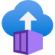
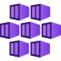

Azure compute services
Azure compute is an on-demand service that provides computing resources such as disks, processors, memory, networking, and operating systems.
Virtual
Machines
App
Services
Container Instances
Azure Kubernetes Services (AKS)
Azure Virtual Desktop
Notes:
https://azure.microsoft.com/products/category/compute/

Slide 4
Azure virtual machines
Azure virtual machines (VMs) are software emulations of physical computers.
Includes virtual processor, memory, storage, and networking.
IaaS offering that provides total control and customization.
Notes:
https://learn.microsoft.com/training/modules/describe-azure-compute-networking-services/2-virtual-machines
Development and test: Azure VMs offer a quick and easy way to create a computer with specific configurations required to code and test an application.
Applications in the cloud: Because demand for your application can fluctuate, it might make economic sense to run it on a VM in Azure. You pay for extra VMs when you need them and shut them down when you don’t.
Extended datacenter: Virtual machines in an Azure virtual network can easily be connected to your organization’s network.
Azure virtual machines: https://azure.microsoft.com/en-us/services/virtual-machines/

Slide 5
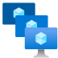
VM scale sets
Scale sets provide a load-balanced opportunity to automatically scale resources.
Scale out when resource needs increase.
Scale in when resource needs are lower.
Notes:
https://learn.microsoft.com/training/modules/describe-azure-compute-networking-services/2-virtual-machines

Slide 6
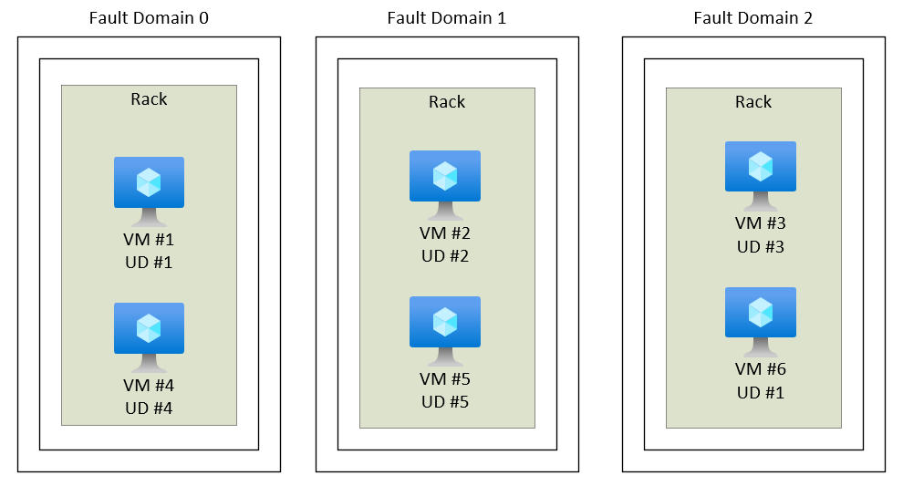
VM availability sets
Notes:
https://learn.microsoft.com/training/modules/describe-azure-compute-networking-services/2-virtual-machines
Update domain keeps VMs grouped if they can be rebooted at the same time without causing an outage.
Fault domains group VMs based on common power and networking.

Slide 7
Examples of when to use VMs
During testing and development
When running applications in the cloud
When extending your datacenter to the cloud
During disaster recovery
Move to the cloud with VMs

Slide 8
VM Resources
Size (purpose, number of processor cores, and amount of RAM)
Storage disks (hard disk drives, solid state drives, etc.)
Networking (virtual network, public IP address, and port configuration)

Slide 9
Azure Virtual Desktop
Azure Virtual Desktop is a desktop and app virtualization that runs in the cloud.
Create a full desktop virtualization environment without having to run additional gateway servers.
Reduce risk of resource being left behind.
True multisession deployments.
Notes:
https://learn.microsoft.com/training/modules/describe-azure-compute-networking-services/4-virtual-desktop
https://learn.microsoft.com/azure/virtual-desktop/overview

Slide 10
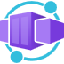
Azure container services
Azure containers provide a lightweight, virtualized environment that does not require operating system management, and can respond to changes on demand.
Azure Container Instances: A PaaS offering that runs a container or pod of containers in Azure.
Azure Container Apps: A PaaS offering, like container instances, that can load balance and scale.
Azure Kubernetes Service: An orchestration service for containers with distributed architectures and large volumes of containers.
Notes:
https://learn.microsoft.com/training/modules/describe-azure-compute-networking-services/5-containers
Containers are a virtualization environment. However, unlike virtual machines, you do not manage an operating system. Containers are meant to be lightweight, and are designed to be created, scaled out, and stopped dynamically.
Azure Container Instances: https://azure.microsoft.com/en-us/services/container-instances/
Azure Kubernetes Service: https://azure.microsoft.com/en-us/services/kubernetes-service/

Slide 11

Azure Functions
Azure Functions: A PaaS offering that supports serverless compute operations. Event-based code runs when called without requiring server infrastructure during inactive periods.
Notes:
https://learn.microsoft.com/training/modules/describe-azure-compute-networking-services/6-functions
Serverless computing is the evolution of cloud platforms in the direction of pure cloud native code. Serverless brings developers closer to business logic while insulating them from infrastructure concerns. It's a pattern that doesn't imply "no server" but rather, "less server." Serverless code is event-driven. Code may be triggered by anything from a traditional HTTP web request to a timer or the result of uploading a file. The infrastructure behind serverless allows for instant scale to meet elastic demands and offers microbilling to truly "pay for what you use." Serverless requires a new way of thinking and approach to building applications and isn't the right solution for every problem.

Slide 12
Comparing Azure compute options
Virtual machines
Virtual Desktop
Containers
Cloud-based server that supports either Windows or Linux environments.
Useful for lift-and-shift migrations to the cloud.
Complete operating system package, including the host operating system.
Provides a cloud-based personal computer Windows desktop experience.
Dedicated applications to connect and use, or accessible from any modern browser.
Multiclient login allows multiple users to log into the same machine at the same time.
Lightweight, miniature environment well suited for running microservices.
Designed for scalability and resiliency through orchestration.
Applications and services are packaged in a container that sits on top of the host operating system. Multiple containers can sit on one host OS.

Slide 13
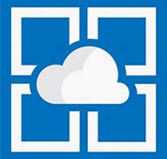
Azure App Services
Azure App Services is a fully managed platform to build, deploy, and scale web apps and APIs quickly.
Works with .NET, .NET Core, Node.js, Java, Python, or php.
PaaS offering with enterprise-grade performance, security, and compliance requirements.
Notes:
https://learn.microsoft.com/training/modules/describe-azure-compute-networking-services/7-describe-application-hosting-options

Slide 14

Azure App Service
Types of app services:
Web apps
API apps
WebJobs
Mobile apps
App Service handles most of the infrastructure decisions:
Deployment and management are integrated into the platform.
Endpoints can be secured.
Sites can be scaled quickly to handle high traffic loads.
The built-in load balancing and traffic manager provide high availability

Slide 15

Azure networking services
Azure Virtual Network (VNet) enables Azure resources to communicate with each other, the internet, and on-premises networks.
Public endpoints, accessible from anywhere on the internet.
Private endpoints, accessible only from within your network.
Virtual subnets segment your network to suit your needs.
Network peering connects your private networks directly together.
Notes:
https://learn.microsoft.com/training/modules/describe-azure-compute-networking-services/8-virtual-networking

Slide 16
Key capabilities
Isolation and segmentation:
Virtual Network allows you to create multiple isolated virtual networks.
When you set up a virtual network, you define a private IP address space by using either public or private IP address ranges.
You can divide that IP address space into subnets.
For name resolution-> name resolution service that's built in to Azure.
Internet communications:
A VM in Azure can connect to the internet by default. You can enable incoming connections from the internet by defining a public IP address or a public load balancer.
Communicate between Azure resources:
Virtual networks: Virtual networks can connect not only VMs but other Azure resources.
Service endpoints: use service endpoints to connect to other Azure resource types (Azure SQL databases and storage accounts).

Slide 17
Key capabilities
Communicate with on-premises resources:
Point-to-site virtual private networks: In this case, the client computer initiates an encrypted VPN connection to Azure to connect that computer to the Azure virtual network.
Site-to-site virtual private networks: A site-to-site VPN links your on-premises VPN device or gateway to the Azure VPN gateway in a virtual network. (The connection is encrypted)
Azure ExpressRoute: provides dedicated private connectivity to Azure that doesn't travel over the internet.
Route network traffic:
Route tables: allows you to define rules about how traffic should be directed. You can create custom route tables.
Border Gateway Protocol: Border Gateway Protocol (BGP) works with Azure VPN gateways or ExpressRoute to propagate on-premises BGP routes to Azure virtual networks.

Slide 18
Key capabilities
Filter network traffic:
Network security groups: it is an Azure resource that can contain multiple inbound and outbound security rules (source and destination IP address, port, and protocol)
Network virtual appliances: A network virtual appliance is a specialized VM that can be compared to a hardened network appliance. A network virtual appliance carries out a particular network function, such as running a firewall or performing wide area network (WAN) optimization.

Slide 19
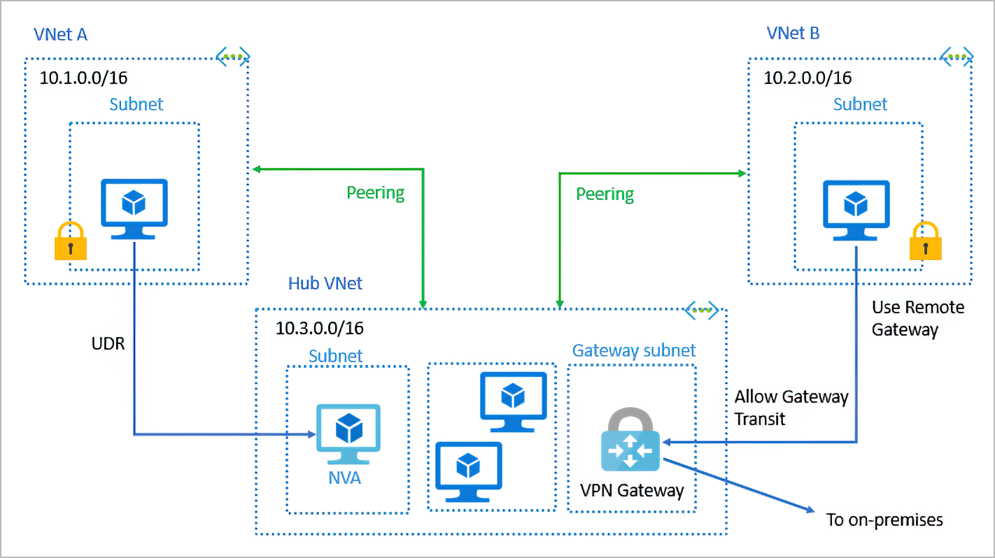
Key capabilities
Connect virtual networks: You can link virtual networks together by using virtual network peering. Peering enables resources in each virtual network to communicate with each other.

Slide 20
VPN
A virtual private network (VPN) is a type of private interconnected network. VPNs use an encrypted tunnel within another network. They're typically deployed to connect two or more trusted private networks to one another over an untrusted network (typically the public internet). Traffic is encrypted while traveling over the untrusted network to prevent eavesdropping or other attacks.

Slide 21
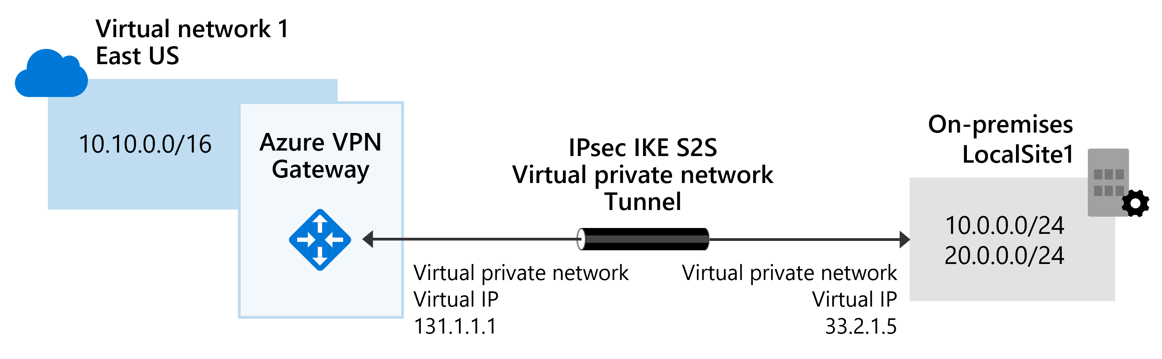

Azure networking services: VPN Gateway
VPN Gateway is used to send encrypted traffic between an Azure virtual network and an on-premises location over the public internet.
Notes:
https://learn.microsoft.com/training/modules/describe-azure-compute-networking-services/10-virtual-private-networks

Slide 22
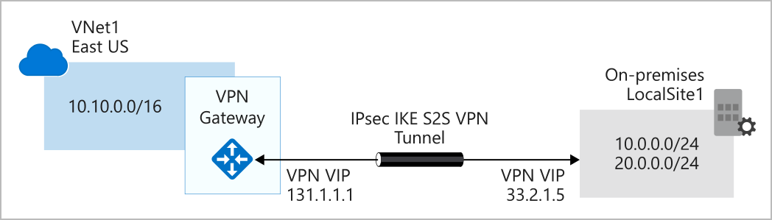
VPN gateways
All data transfer is encrypted inside a private tunnel as it crosses the internet.
You can deploy only one VPN gateway in each virtual network.
VPN types: policy-based vagy route-based.

Slide 23
VPN types
Policy-based VPN gateways specify statically the IP address of packets that should be encrypted through each tunnel.
In Route-based gateways, IPSec tunnels are modeled as a network interface or virtual tunnel interface. IP routing (either static routes or dynamic routing protocols) decides which one of these tunnel interfaces to use when sending each packet.

Slide 24
Route-based VPNs
With route-based gateways, IPSec tunnels are modeled as a network interface or virtual tunnel interface.
IP routing decides which one of these tunnel interfaces to use when sending each packet.
Use a route-based VPN gateway if you need any of the following types of connectivity:
Connections between virtual networks
Point-to-site connections
Multisite connections
Coexistence with an Azure ExpressRoute gateway

Slide 25
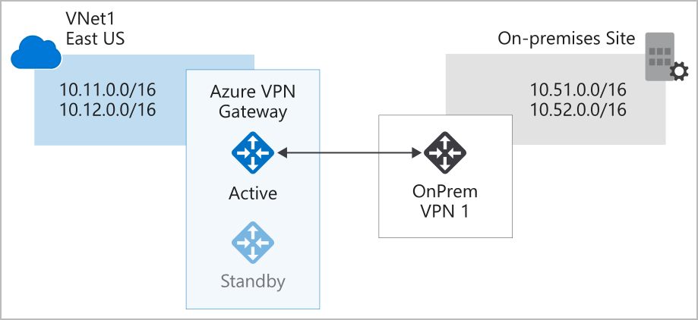
Active/standby
By default, VPN gateways are deployed as two instances in an active/standby configuration.

Slide 26
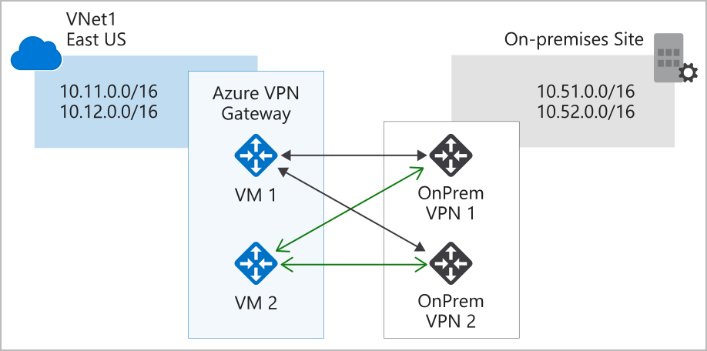
Active/Active
With the introduction of support for the BGP routing protocol, you can also deploy VPN gateways in an active/active configuration.

Slide 27
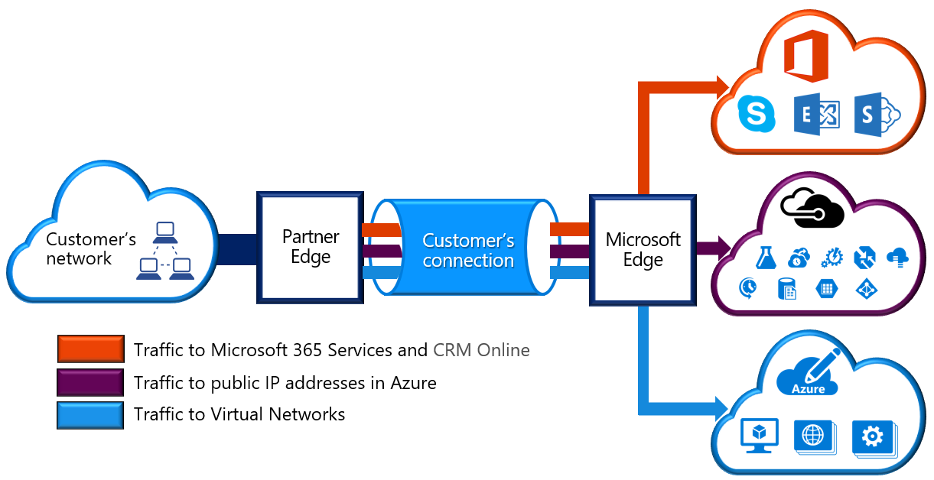
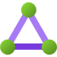
Azure networking services: ExpressRoute
ExpressRoute extends on-premises networks into Azure over a private connection that is facilitated by a connectivity provider.
Notes:
https://learn.microsoft.com/training/modules/describe-azure-compute-networking-services/11-expressroute/

Slide 28
Other features
Another high-availability option is to configure a VPN gateway as a secure failover path for ExpressRoute connections. ExpressRoute circuits have resiliency built in.
In high-availability scenarios, where there's risk associated with an outage of an ExpressRoute circuit, you can also provision a VPN gateway that uses the internet as an alternative method of connectivity.

Slide 29
Features and benefits of ExpressRoute
Layer 3 connectivity between your on-premises network and the Microsoft Cloud through a connectivity provider. Connectivity can be from an any-to-any (IPVPN) network, a point-to-point Ethernet connection, or through a virtual cross-connection via an Ethernet exchange.
Connectivity to Microsoft cloud services across all regions in the geopolitical region.
Global connectivity to Microsoft services across all regions with the ExpressRoute premium add-on.
Dynamic routing between your network and Microsoft via BGP.
Built-in redundancy in every peering location for higher reliability.
Connection uptime SLA.

Slide 30
Features and benefits of ExpressRoute
Each connectivity provider uses redundant devices to ensure that connections established with Microsoft are highly available.
ExpressRoute enables direct access to the following services in all regions:
Microsoft Office 365
Microsoft Dynamics 365
Azure compute services, such as Azure Virtual Machines
Azure cloud services, such as Azure Cosmos DB and Azure Storage
You can enable ExpressRoute Global Reach to exchange data across your on-premises sites by connecting your ExpressRoute circuits.
ExpressRoute uses the Border Gateway Protocol (BGP) routing protocol. BGP is used to exchange routes between on-premises networks and resources running in Azure. This protocol enables dynamic routing between your on-premises network and services running in the Microsoft cloud.

Slide 31
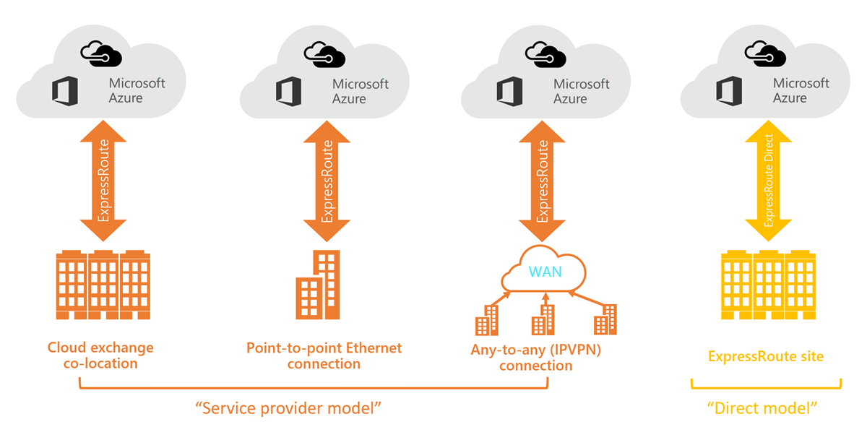
ExpressRoute connectivity models
ExpressRoute supports four models:
CloudExchange colocation
Point-to-point Ethernet connection
Any-to-any connection
Directly from ExpressRoute sites

Slide 32
Other features
Security considerations: With ExpressRoute, your data doesn't travel over the public internet, so it's not exposed to the potential risks associated with internet communications. ExpressRoute is a private connection from your on-premises infrastructure to your Azure infrastructure. Even if you have an ExpressRoute connection, DNS queries, certificate revocation list checking, and Azure Content Delivery Network requests are still sent over the public internet.

Slide 33

Azure DNS
Reliability and performance by leveraging a global network of DNS name servers using Anycast networking.
Azure DNS security is based on Azure resource manager, enabling role-based access control and monitoring and logging.
Ease of use for managing your Azure and external resources with a single DNS service.
Customizable virtual networks allow you to use private, fully customized domain names in your private virtual networks.
Alias records support alias record sets to point directly to an Azure resource.
Notes:
https://learn.microsoft.com/training/modules/describe-azure-compute-networking-services/12-domain-name-system

Slide 34
Questions
Which Azure Virtual Machine feature staggers updates across VMs based on their update domain and fault domain?
Availability sets
Scale sets
Update sets

Slide 35
Questions
2. Which Azure service allows users to use a cloud hosted version of Windows from any location and connect from most modern browsers?
Azure Virtual Desktop
Azure Virtual Machines
Azure Container Instances

Slide 36
Questions
3. Which of the following statements about virtual machines (VMs) and containers is true?
Select all that apply.
All VMs share the same operating system instance
VMs are isolated from the host hardware, while containers are not
All containers share the same operating system instance
VMs and containers are isolated from the host hardware

